Slide 1

Immune Receptor Profiling Nanocourse: Session 2- Community standards, Data analysis and interpretation
Organized by the VDJServer Team
June 1, 2018
UT Southwestern Medical Center

Slide 2
AGENDA
8:45am – 9:00am Setup, Registration, provide workshop handouts to participants
9:10am – 10:30am Introduction session
9:10am – 10:30am: Immune system overview (including immune sequencing technology and summary of vdjserver workflow for analysis); Setup IgBlast jobs with demo files
Show slides and video
10:30am-10:40am Break
10:40am – 11:45am Session 1- Data digest
Demo data and VDJServer hands-on demonstrations
Elaborate on the functionalities and benefits of VDJServer such as: no need to install anything, reproducibility, easy to use, data is stored on your account and is private, collaborative sharing of data, and long term archiving.
Breakout and setup RepCalc VDJServer “jobs” (provide one-on-one assistance and point participants to quickstart protocol @ handout pages)
11:45am – 1:00pm Lunch
1:00pm – 2:40pm Session 2- Community standards, Data analysis and interpretation
Look at example of pre-processing using FASTQ files
MiAIRR Standards overview and discussion
Analysis and interpretation of repertoire calculations output
2:40pm-2:55pm Break
3:00pm-3:45pm
Downstream application of VDJServer products in machine learning (example dataset using the demo dataset and discussion of some outcomes)
3:45pm-4:15pm
Summarize the workshop and encourage future interactions
Invitation to use some example datasets for further analysis (VDJServer team will assist in setup as time permits)

Slide 3
Session 2 objectives
Demonstration of pre-processing tasks using fastq files (using example data from a vdjserver project)
Review the MiAIRR Standards (discuss the steps involved and how to approach these steps for submission of data during publication)
Analyze and interpret data from repertoire calculations

Slide 4
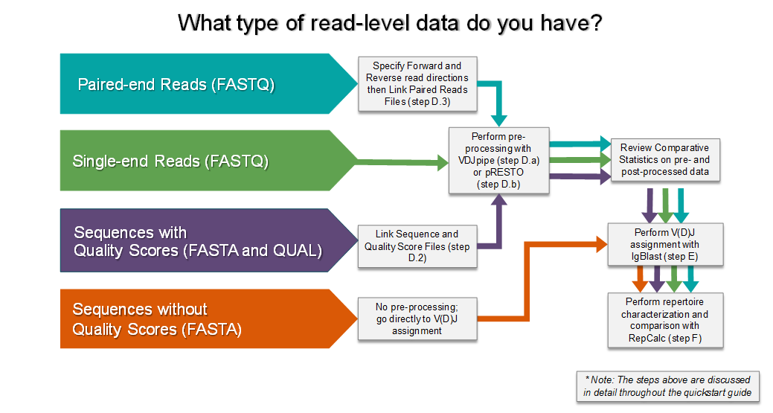
Pre-processing with Fastq files

Slide 5
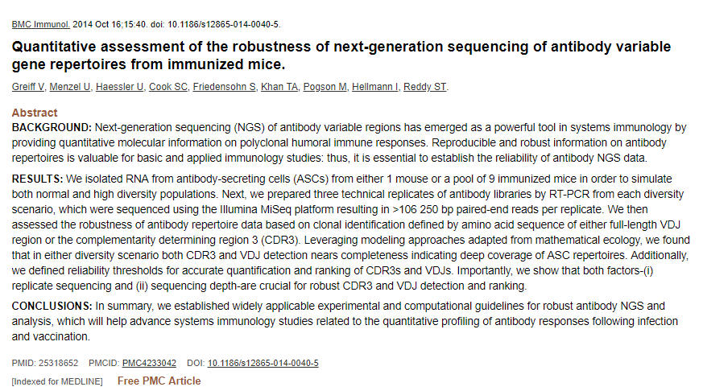
Pre-processing example using AIRR community data (reference manuscript)

Slide 6
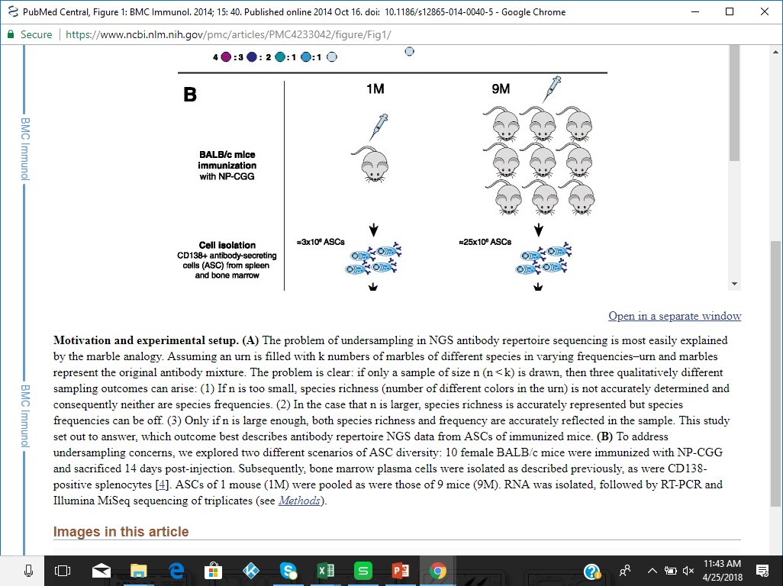
Experimental Setup (reference manuscript)

Slide 7
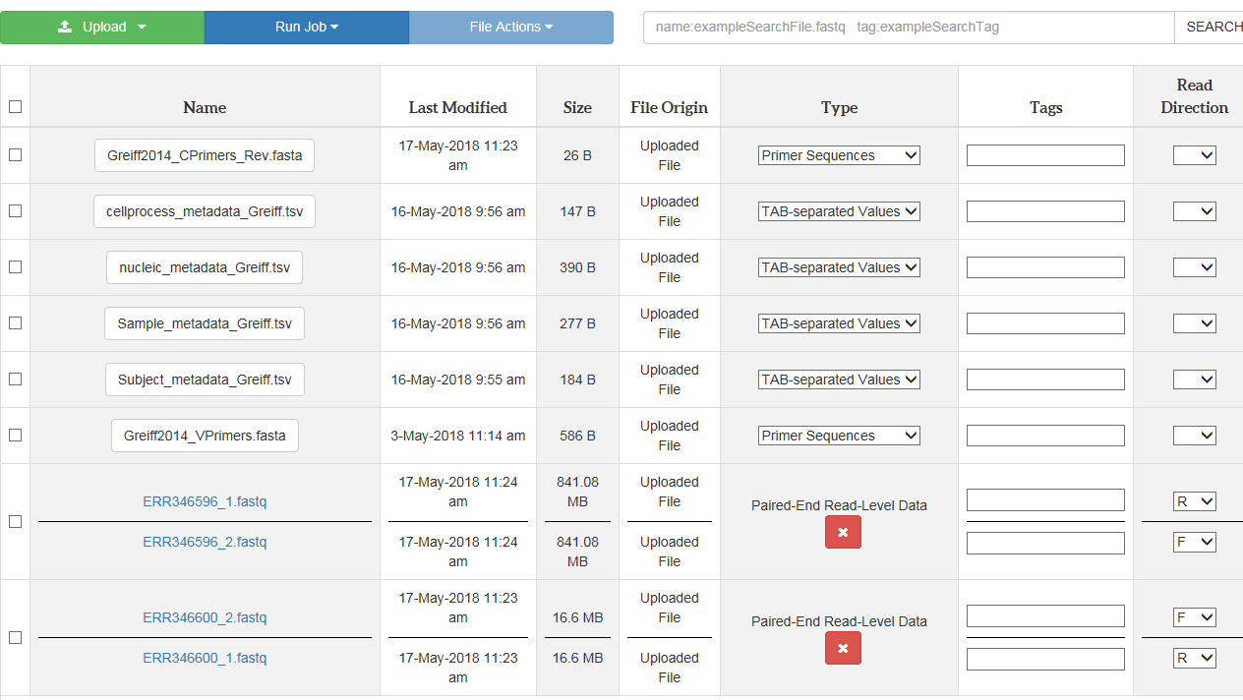
A look at the vdjpipe application (exploring pre-processing steps on VDJServer)

Slide 8
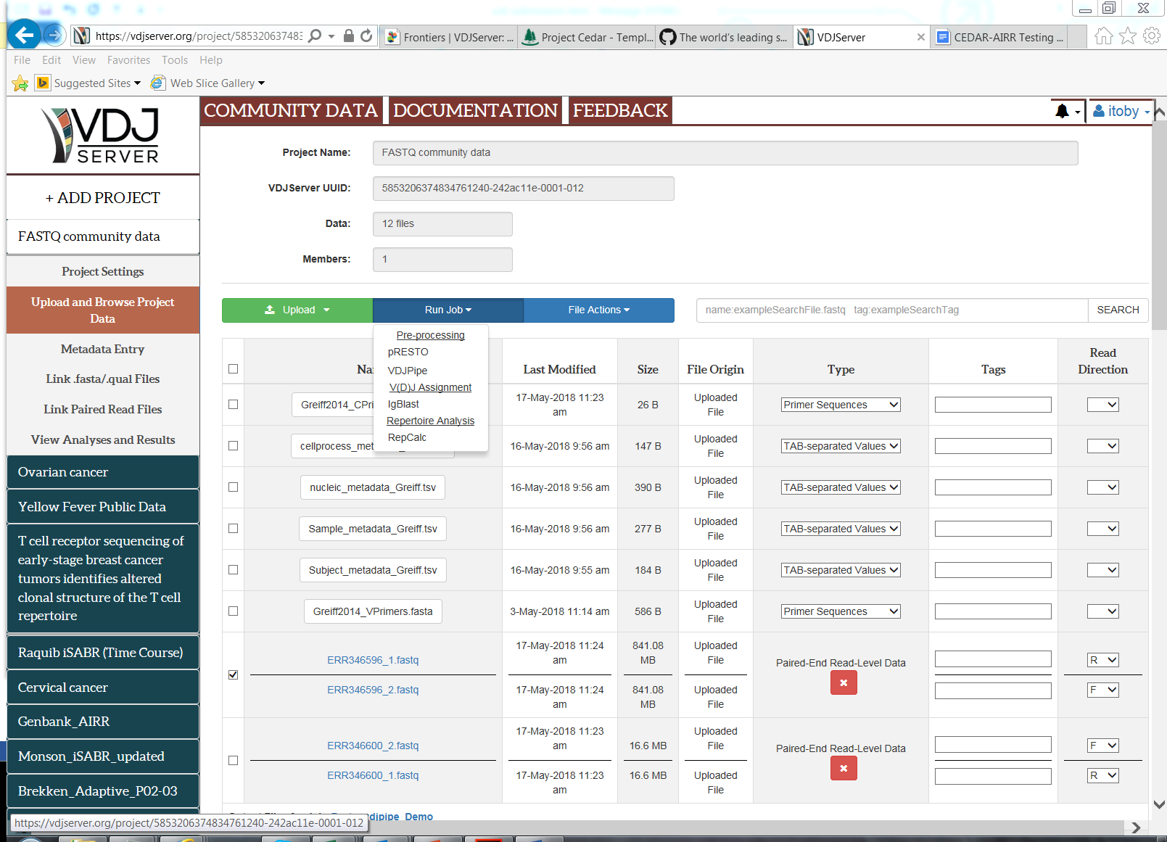

Slide 9
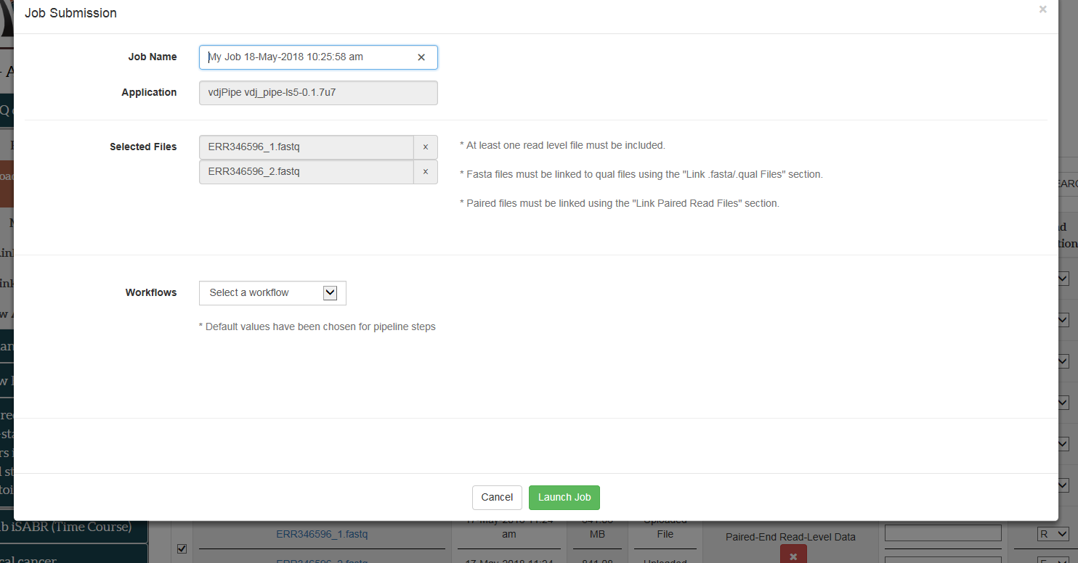

Slide 10
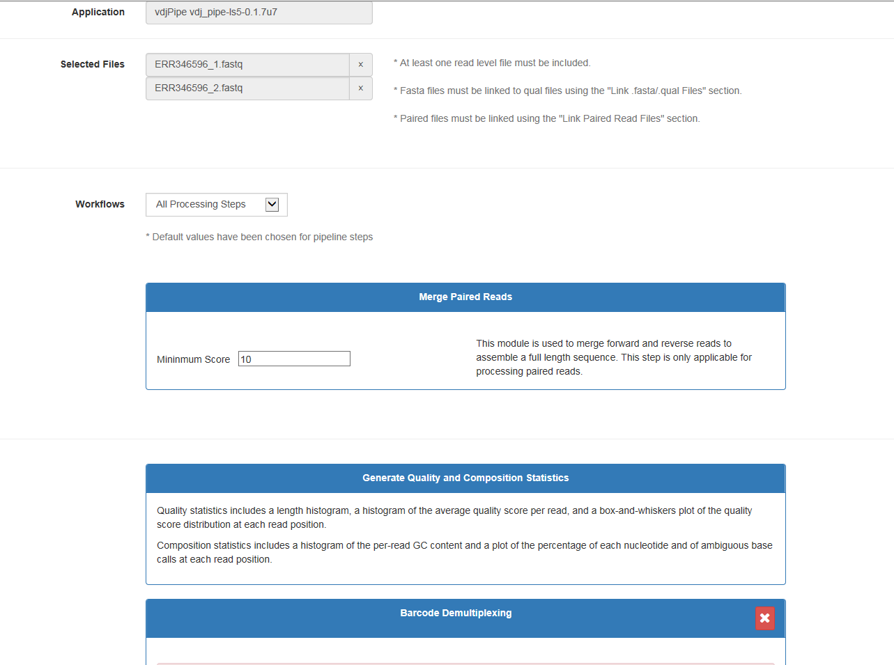

Slide 11
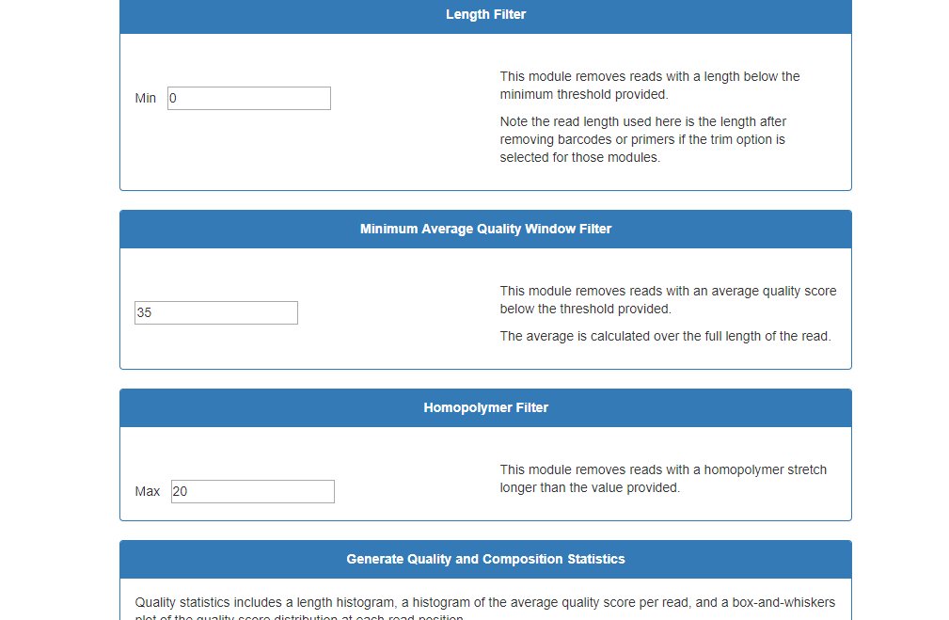

Slide 12
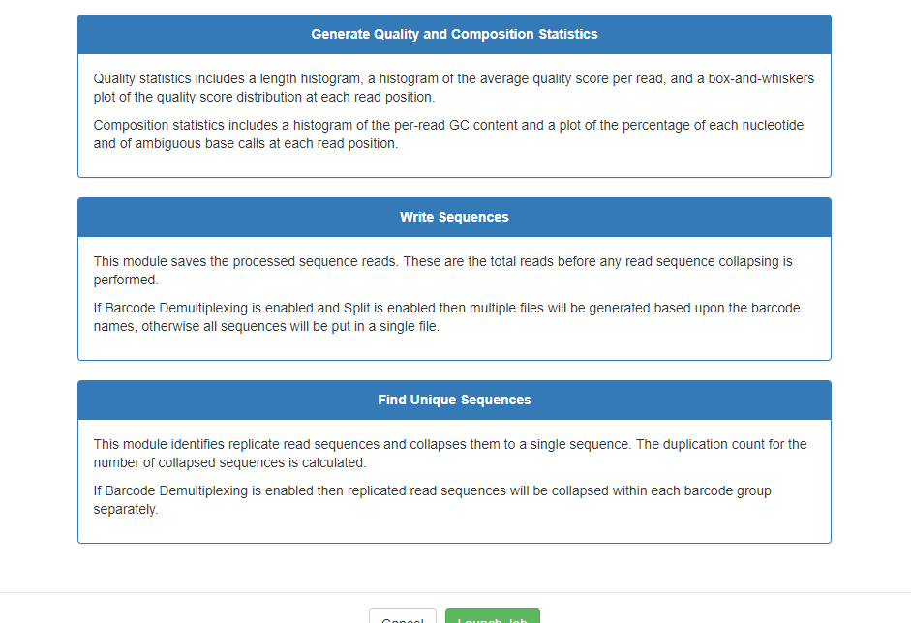

Slide 13
Pre-processing with Fastq files (review)

Slide 14
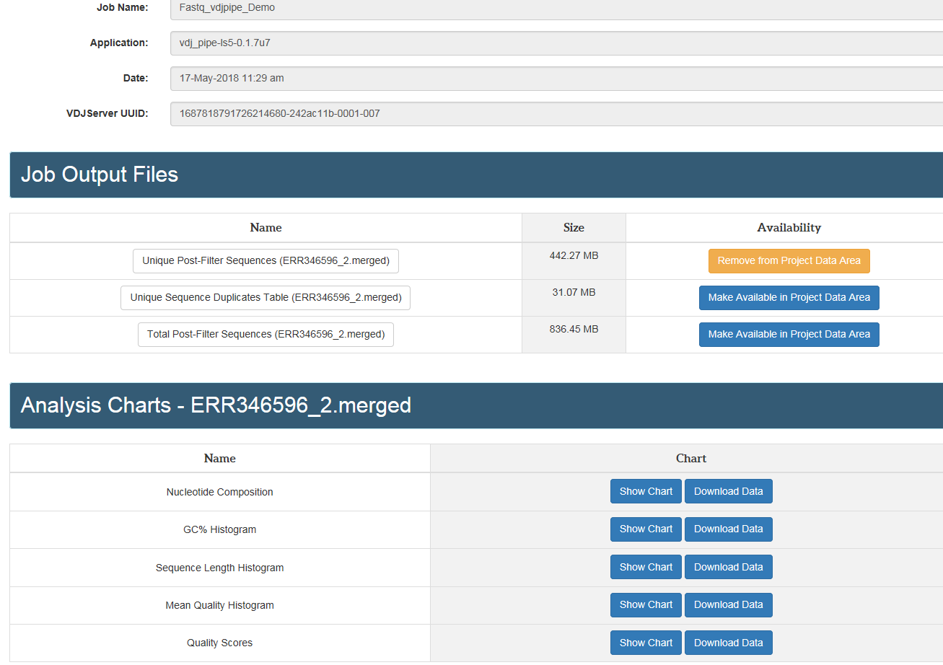
Output files from pre-processing steps

Slide 15
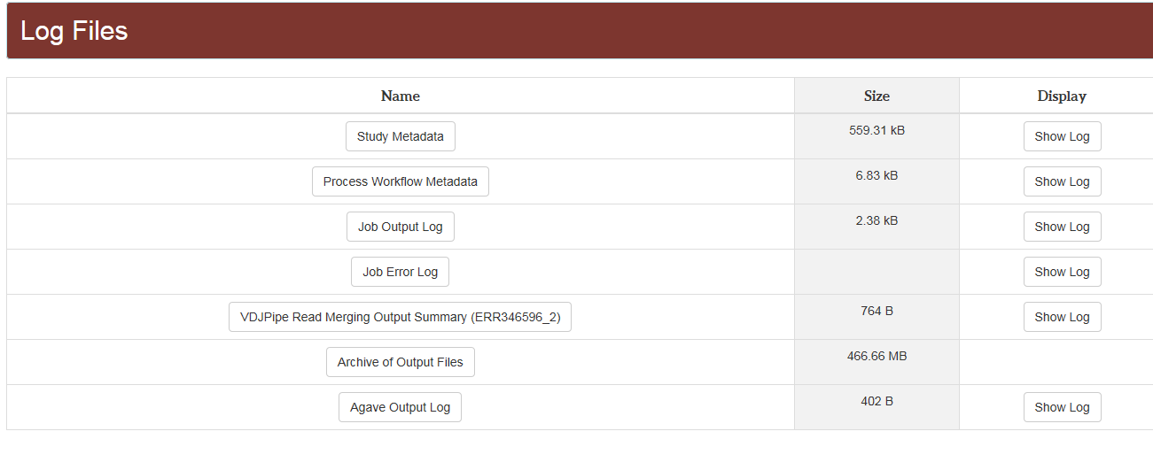
Output files from pre-processing steps

Slide 16
Pre-processing summary
Files uploaded to VDJServer
Selection of processing steps for vdjpipe application
Run files and generate processed fasta files
Proceed with vdj assignment using the IgBlast application and followed by repertoire calculations (using repcalc)

Slide 17
AIRR Community and MiAIRR Standards
Reference handouts

Slide 18
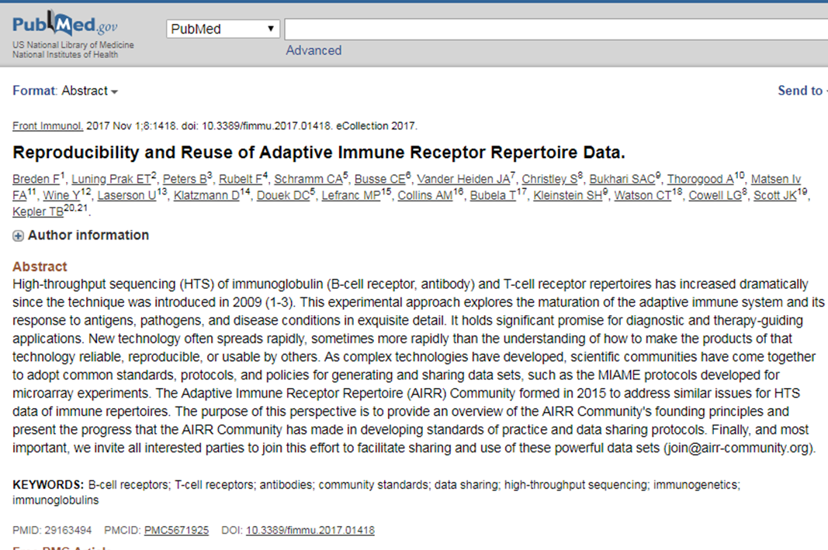

Slide 19
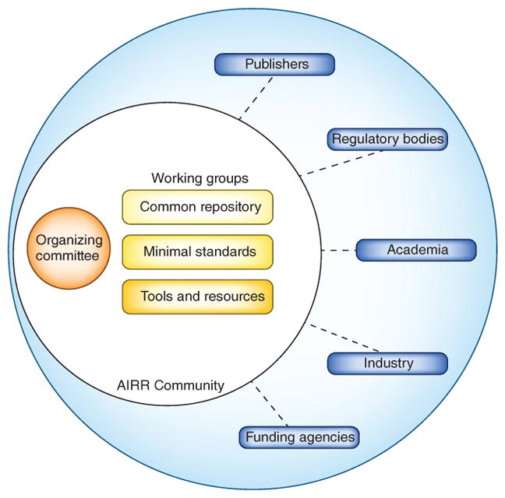
AIRR community interactions

Slide 20
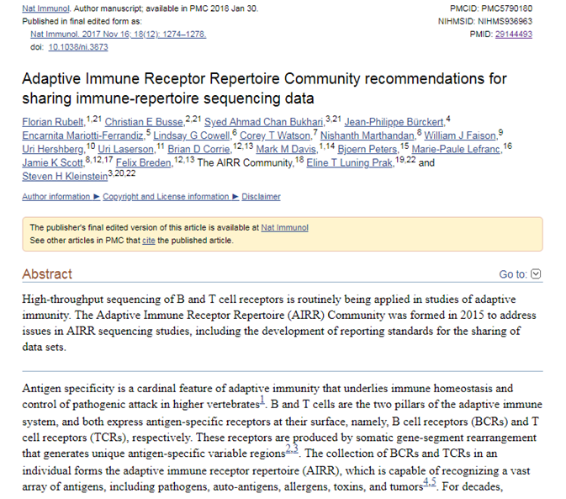

Slide 21
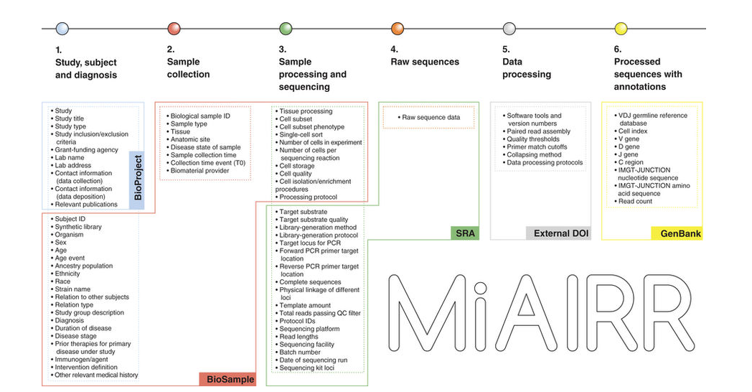

Slide 22
Summary
The Adaptive Immune Receptor Repertoire (AIRR) Community formed in 2015 to address reproducibility and reuse issues for HTS data of immune repertoires.
The community has made significant progress in developing standards of practice and data sharing protocols.
The key recommendations set forth comprise of six MiAIRR sets and associated data fields, along with their target submission repositories to promote data standardization across all the studies within the community.
VDJServer enables you to fulfill all of the MiAIRR submission requirements covered by the six sets and also provides you with a “one-stop” shop from start to finish.

Slide 23
Repertoire Calculations Overview

Slide 24
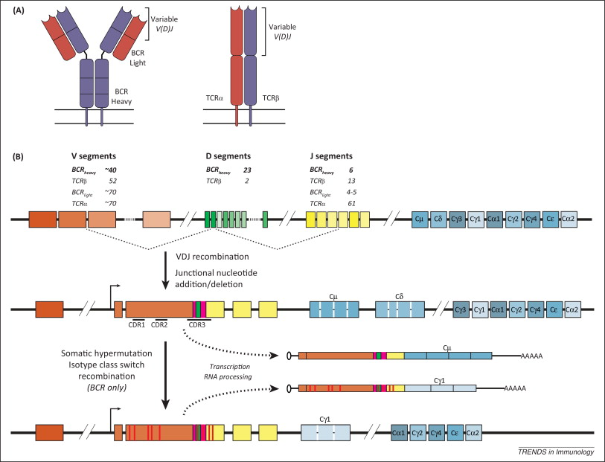
Schematic for VDJ recombination in B and T cells
PMID: 25306219

Slide 25
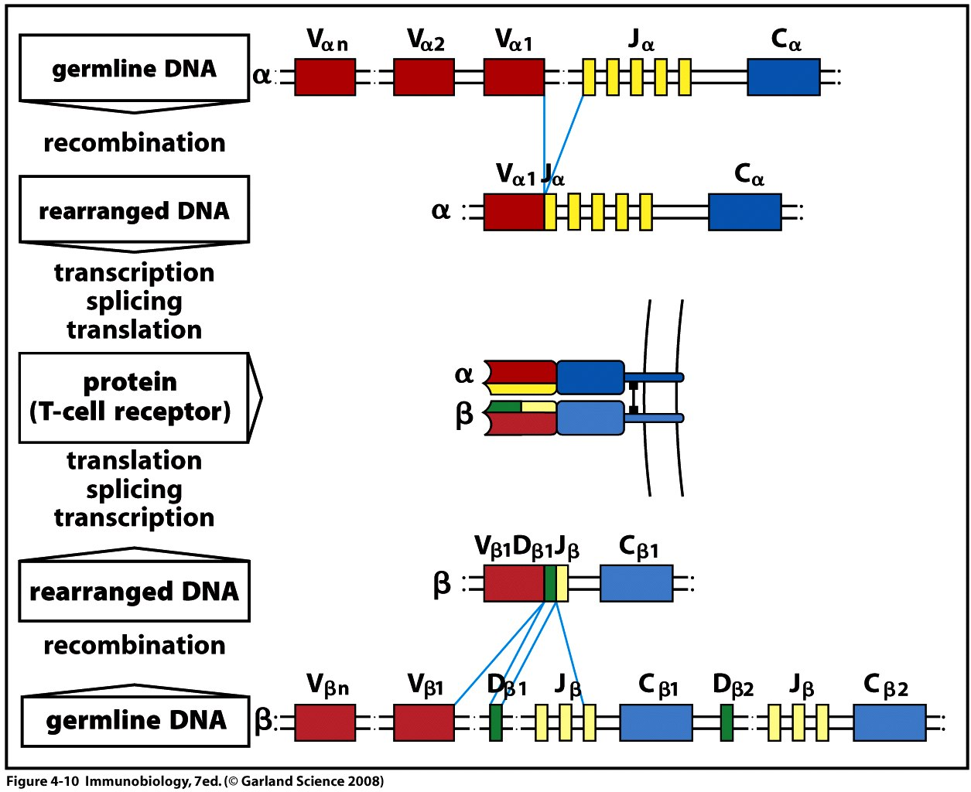
T Cell Receptors
Total Diversity: ~10¹⁸
V(D)J Recombination
Janeway and Travers remix
Notes:
Based on the number of gene segments of each type in humans and the patterns of junctional diversity, it is estimated that the total potential alpha:beta TCR diversity is ~10^18.

Slide 26
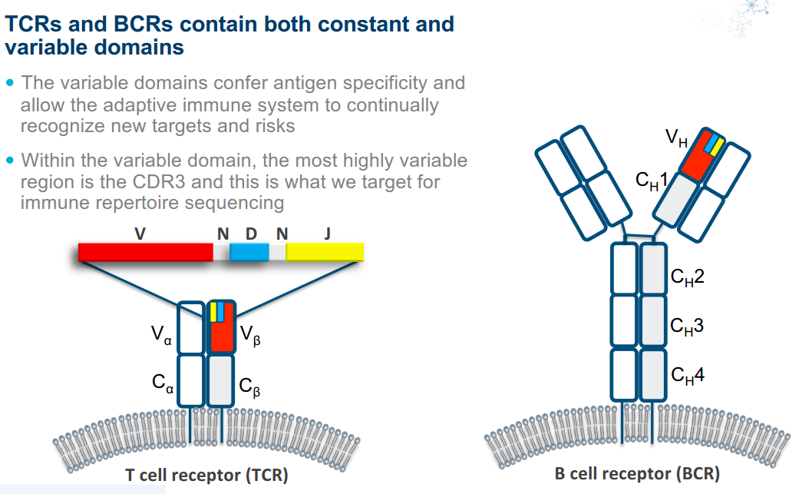
T-Cell Receptor CDR3 Region
CDR3

Slide 27
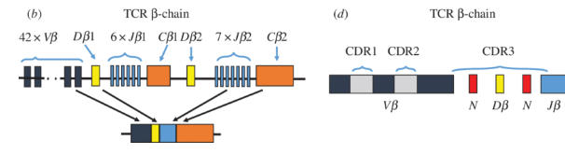
Typical data analysis questions (some examples)
What are gene segment usage (V/D/J) patterns across samples?
What are the cdr3 sequence (clonal) abundance patterns across samples?
What is the diversity observed across samples?
Which cdr3 sequences are shared across samples?
Data analysis questions can be targeted at:
subject
sample
sample group (using available metadata)

Slide 28
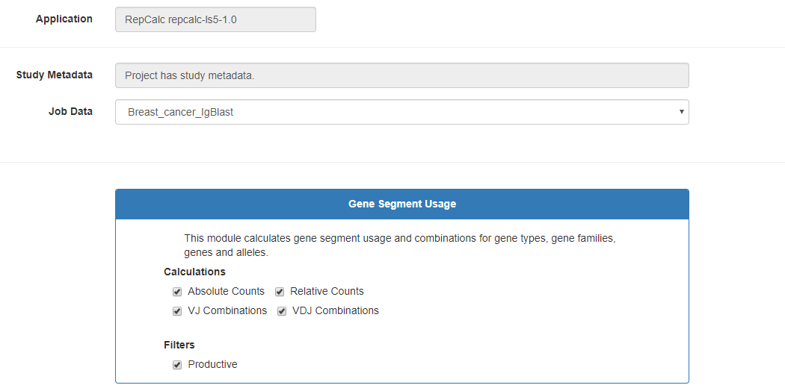
Exploring repertoire calculation options on VDJServer
Gene Segment Usage
Relative and absolute Counts of V, D, and J genes

Slide 29
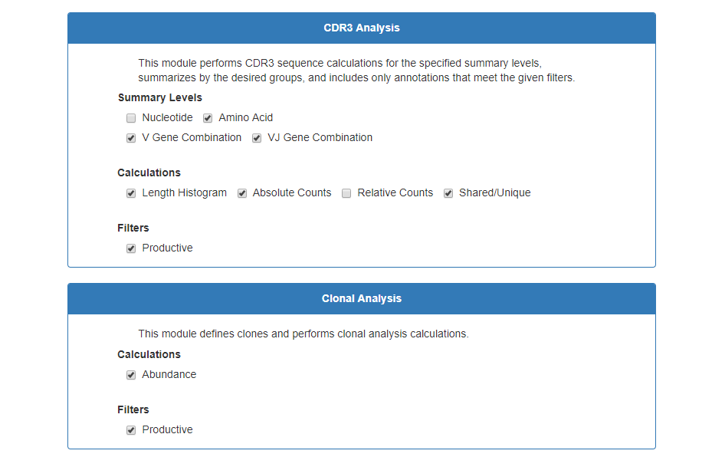
CDR3 analysis
Counts
Sharing level calculations
Clonal analysis
Abundance counts
Graphs

Slide 30
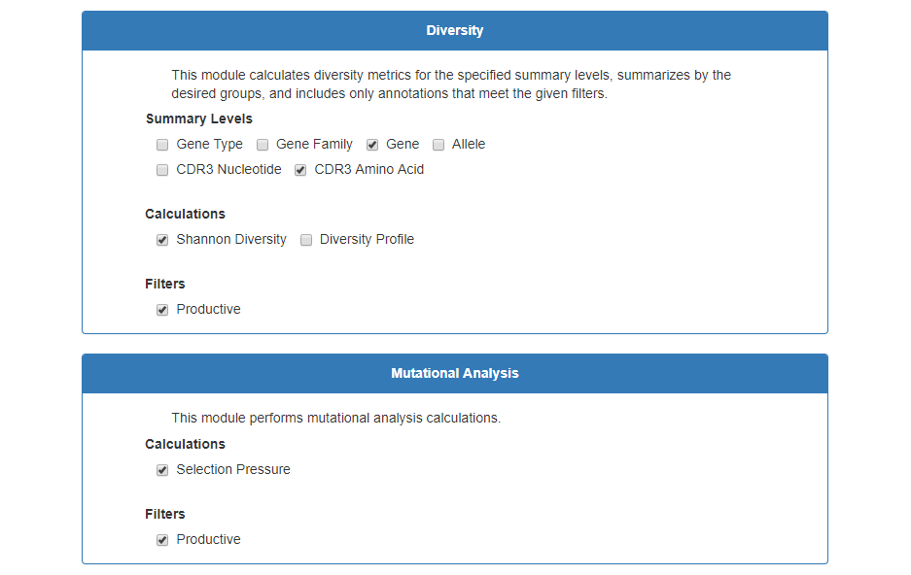
Diversity
Diversity index metric
Mutational analysis
Selection pressure (this applies to immunoglobulin (B-cell) receptors (see slide #24).

Slide 31
Review of RepCalc output results
Reference manuscripts for detailed information on module calculations for clonal abundance and diversity:
https://www.ncbi.nlm.nih.gov/pubmed/?term=28179494+26589402+26069265+25675496+24618469+22641856+24298272%5Buid%5D
Overview of the log files provided by repcalc application
(highlight-Archive of output files)
Discussion of CDR3 clones and clonal comparison approaches
Discussion of research questions and review of findings

Slide 32
Clonal Abundance
A clone is a group of identical cells that share a common ancestry, meaning they are derived from the same cell.
Clonal abundance is the prevalence of a given clone within a given dataset.
This metric uses the observed clonal frequencies, where the size of each clone is determined by the number of sequence members
Reference:
https://cran.r-project.org/web/packages/alakazam/vignettes/Diversity-Vignette.pdf

Slide 33
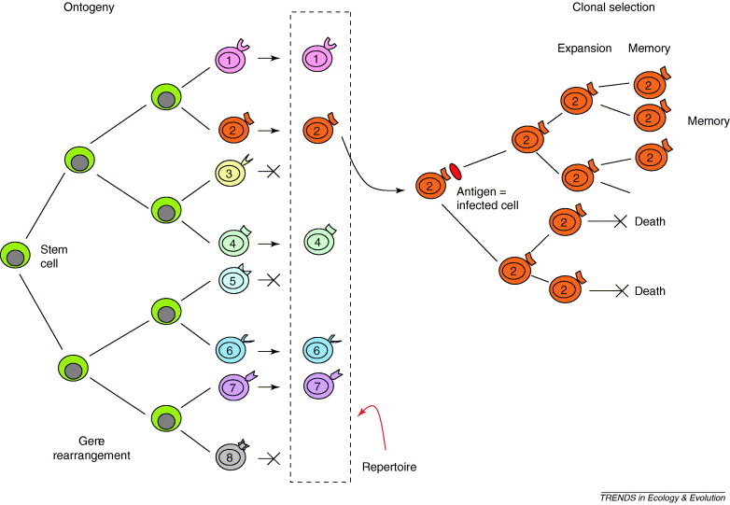
Clones and Clonal expansion (example in T-Cell Receptor Repertoire)
Random generation of antigen receptors
Thymic
selection
Clonal expansion
Modified from Bergstrom and Antia, 2006. Trends Ecol Evol
Notes:
The antigen receptor encoding genes are generated in developing lymphocytes as just described. The lymphocytes then undergo selection in the thymus such that T cells bearing TCR with specificity for self antigen are deleted from the repertoire. The remaining cells exit the thymus, and crawl around the body sampling the antigens they encounter. Upon encounter with their cognate antigen, they will proliferate, creating a clone of cells bearing identical TCRs. This is referred to as clonal expansion.
The full set of functional TCRs in an individual at a specific time is referred to as the TCR repertoire.

Slide 34
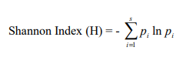
Diversity
Species diversity is a measurement of species richness and species evenness.
Richness is the number of species
Evenness refers to how close in numbers each species in an environment is.
Diversity index is quantitative measure that reflects richness and evenness.
https://cran.r-project.org/web/packages/alakazam/vignettes/Diversity-Vignette.pdf
https://en.wikipedia.org/wiki/Diversity_index
Notes:
how many different types of sequences there are in the dataset, and simultaneously takes into account how evenly the sequences are distributed among those types.

Slide 35
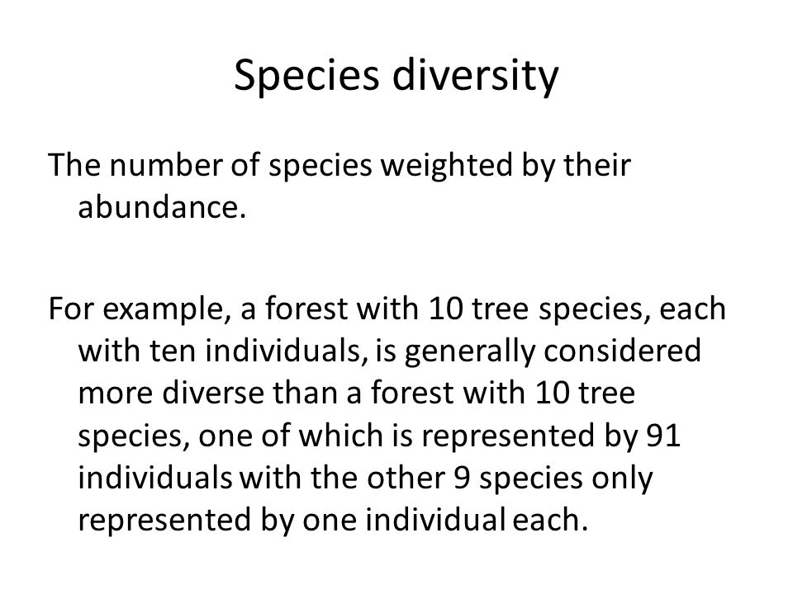
Diversity example

Slide 36
Selection Pressure
Selection pressure- factors that contribute to selection which variations will provide the individual (sequence) with an increase chance of surviving over others.
Can be positive or negative
An example of this is DNA mutation patterns resulting from a mutator that displays hot/cold-spots, substitution preference or other intrinsic biases
PMID: 22641856
Notes:
Calculation approach utilized in repcalc works by building a statistical framework for Bayesian estimation of antigen-driven selection based on the analysis of somatic mutation patterns

Slide 37
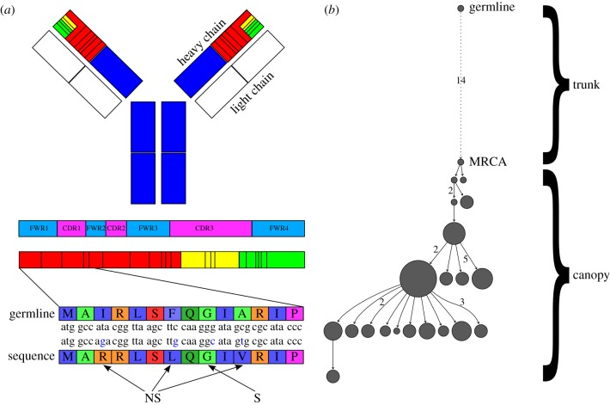
Selection pressure (example in B cells)
Antibodies are composed of two identical heavy chains and two identical light chains. The mRNA coding for each chain is divided into FWRs and CDRs, which are interlaced in the linear genetic code. To identify the somatic mutations that are accumulated during affinity maturation, antibody sequences are first aligned with the corresponding inferred germline sequence.

Slide 38
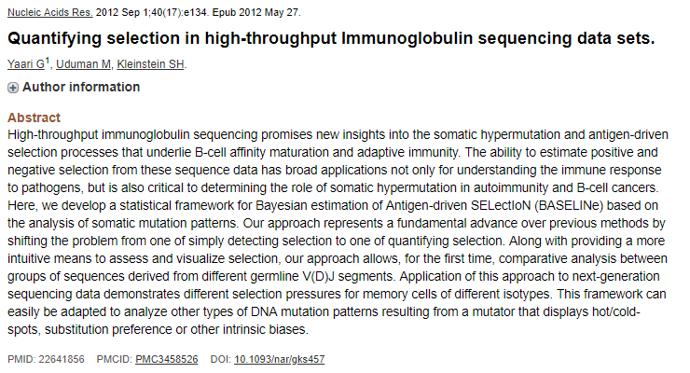

Slide 39
Additional example slides
Datasets from VDJServer community project

Slide 40
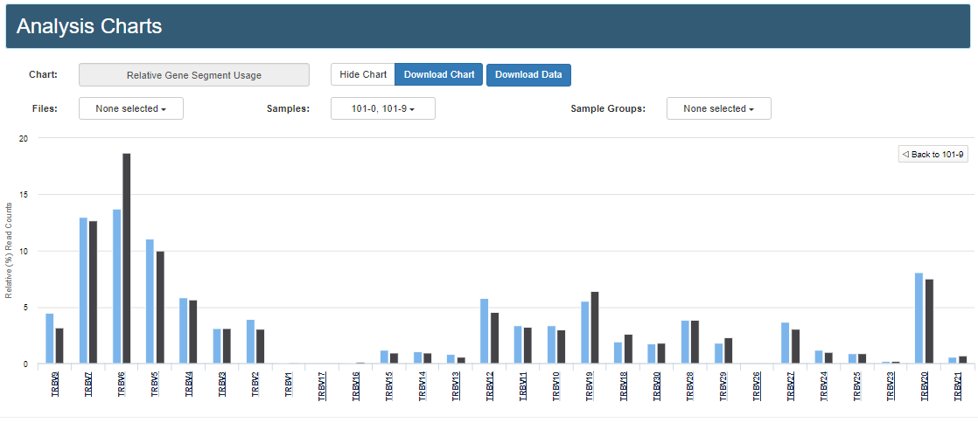
Example data showing gene segment usage
Blue- pre-treatment (0 wk)
Black- post treatment (9 wk)

Slide 41
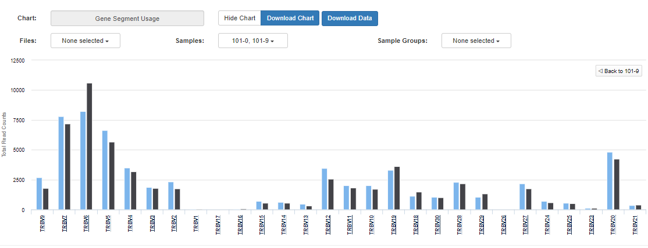
Blue- pre-treatment (0 wk)
Black- post treatment (9 wk)

Slide 42

Summary
VDJServer offers interactive visualizations for users
VDJServer executes all steps and generates analysis reports complete with data summary tables, statistical analyses, figures and workflow logs
VDJServer improves the efficiency of analysis by eliminating the need for significant manual manipulation of data
This improves data accuracy and reliability
VDJServer makes sophisticated computational calculations easily accessible

